Slide 1
Lecture #1
Data collection (1/2): Files processing

Slide 2
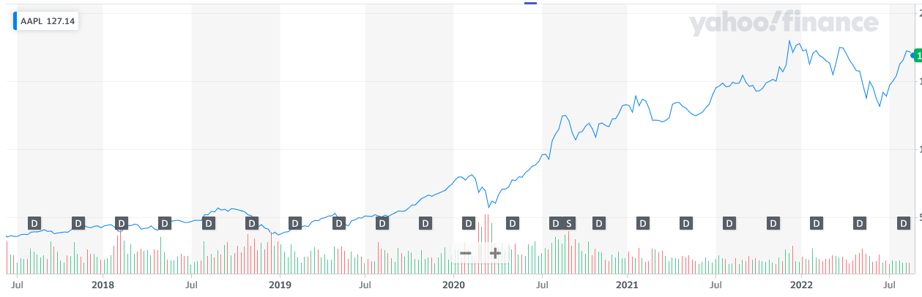
Introduction: The stock market example
Influence by many factors
Data science is used to predict it

Slide 3
Introduction
Collecting data is the first step of data analysis
Highly available in many forms
Computer readable:
.csv
.json
.xml
Human readable:
Excel

Slide 4
CSV file
« Comma-Separated Values »
One of the most common data file
Used in sensors (temperature, pressure, …)
A header
Data separated by character (comma)
Can be opened with:
Text editor (notepad)
Excel

Slide 5
Use csv data
Import package csv
Open the csv file with Python
Use the csv reader function or DictReader function
All the data are now available in your python program
The writer function create a csv file
More information on “https://docs.python.org/3/library/csv.html”

Slide 6
JSON file
“JavaScript Object Notation”
One of the most common data file
Used by websites
Stored under dictionary shape

Slide 7
Use json data
Import package json
Open the json file with Python
Use the json loads function
All the data are now available in your python program as a dictionary
More information on “https://docs.python.org/3/library/json.html”

Slide 8
XML file
“eXtensible Markup Language”
Use different tags
Can be opened in:
Text editor
Web browser (interaction possible)

Slide 9
Use XML file
More complicated than other files
Import package xml.etree.ElementTree
Get root
Browse items and category
Modify item.text to change values and save the file
More information on “https://docs.python.org/3/library/xml.etree.elementtree.html”

Slide 10
Human readable file : Excel
Highly available
Very common for most of companies
Difficult to manage
Solutions:
Search other form
export to csv from excel option
Use python
Can be use to show results

Slide 11
Human readable file : Excel
Package : xlrd
Open Workbook
Open tab
Use the function “cell_value(rowx, colx)” to find the value of the wanted cell
More information at “https://xlrd.readthedocs.io/en/latest/”

Slide 12
Write Excel files
Useful to present result to public
Package : xlwt
Open Workbook
Create tab
Use the function “write(row,col,value)” and use “Formula(row,col,formula)” as a value
More information at “https://pypi.org/project/xlwt/”

Slide 13
Human readable files : PDF
Two citations from “Data wrangling with Python”:
“Publishing data only in PDFs is criminal” page 91
“Just because you know a tool like Python doesn’t mean it’s always the best tool for the job.” page 92
When nothing else work
Many available packages
Highly depend on PDF type
Download and try is the only way

Slide 14
The next step : Make the data usable
Transform your data into usable data for your script :
Lists
Dictionary
Use pprint to improve the display of data

Slide 15
Transform your data
Float function to transform string into number
Datetime package to transform string to date
Datetime function to create date and time
Strptime to transform string object to datetime object
More information at “https://docs.python.org/3/library/datetime.html”

Slide 16
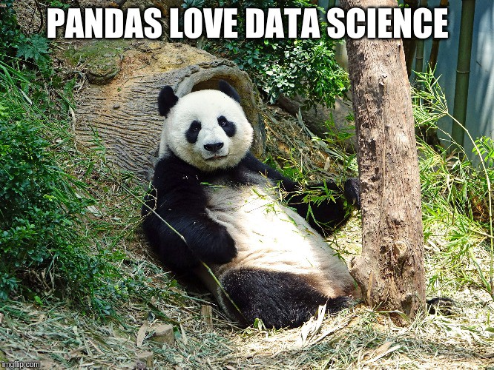
Pandas and dataframe
Raw data is not easily usable
Best library to manage data
Help to visualize data and make calculation on it
One line is always together

Slide 17

Pandas series
A column of the Dataframe (1 dimension)
The index can be modified
Automatic if from a dictionary
A Dataframe can be created from Series

Slide 18


Pandas
Create a Dataframe from a dictionary or Series
Dataframes have indexes
Indexes

Slide 19
Pandas Dataframe
Use .loc to locate a row :
Return a Serie if a int is used
Return a Dataframe is a list is used
You can rename indexes with the index argument and still get access to it with .loc

Slide 20
Pandas for data science
Transform directly a csv file to a dataframe (“read_csv” method)
Transform directly a json file to a dataframe (“read_json” method)
Use “.to_string()” method to display all the information
You can change the number of displayed rows with “.options.display.max_rows”
More information on “https://www.w3schools.com/python/pandas/pandas_intro.asp”

Slide 21
Question ?

